Slide 1
Importance of Offroad to Ozone Formation in Midwest
Mark Janssen – LADCO

Slide 2
Impact of Offroad in Midwest.

Slide 3
Impact of Offroad in Midwest.

Slide 4
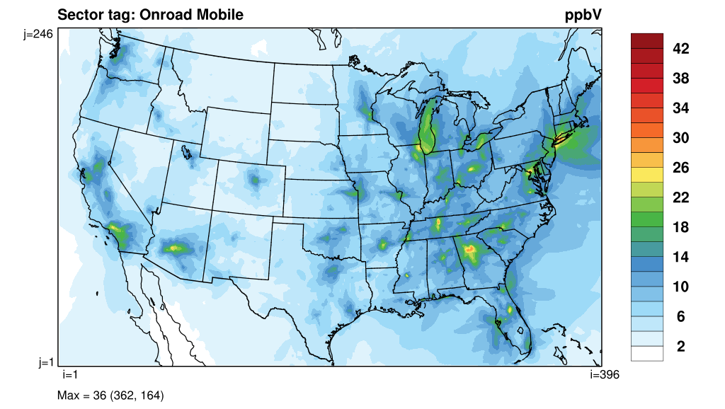

Slide 5
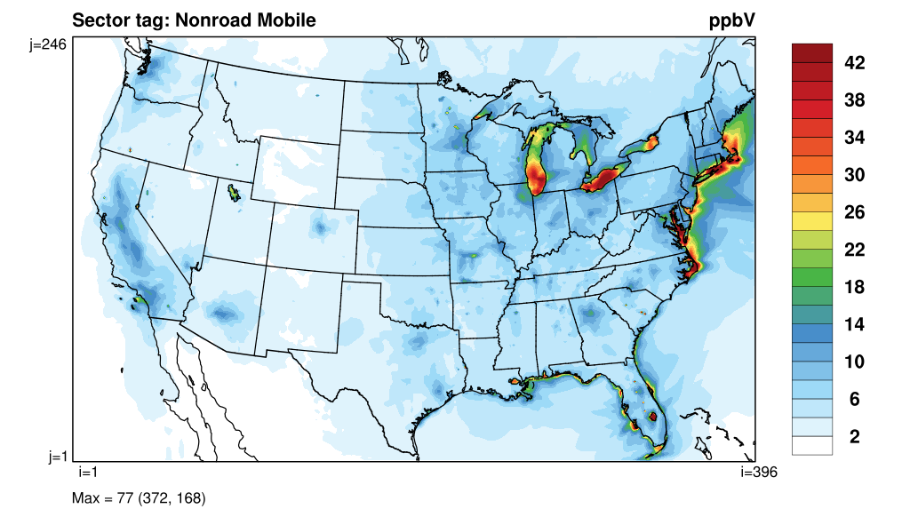

Slide 7
Fraction of Wisconsin Statewide boating use by County

Slide 8
Conclusion
Nonroad has a significant impact on regional ozone over water
Motorboat usage on great lakes does not seem incorrectly modeled based on EPA surrogates.
Fraction of activity between counties in Wisconsin seems to be off. Non-lake Michigan counties seem to be under counted in ”tourist” lake counties.

